Slide 1
CEM/
SCEM
CEM/
SCEM
CEM/
SCEM
BPM
AEM
BPM
AEM
BPM
AEM
BPM
-
+
-
-
+
-
-
+
-
-
+
+
+
+
-
+
-
+
-
-
+
-
-
+
-
-
+
+
+
+
-
-
-
-
-
-
-
+
+
+
EC
SWBC
AC
BC
AC，EC用全称
Fig. 1 The configuration of lab-scale experimental BMED stack (EC: electrode chamber; SWBC: seawater brine chamber; AC: acid chamber; BC: base chamber).
Notes:
Fig. 1 The configuration of BMED stack (EC: electrode chamber; SWBC: seawater brine chamber; AC: acid chamber; BC: base chamber).

Slide 2
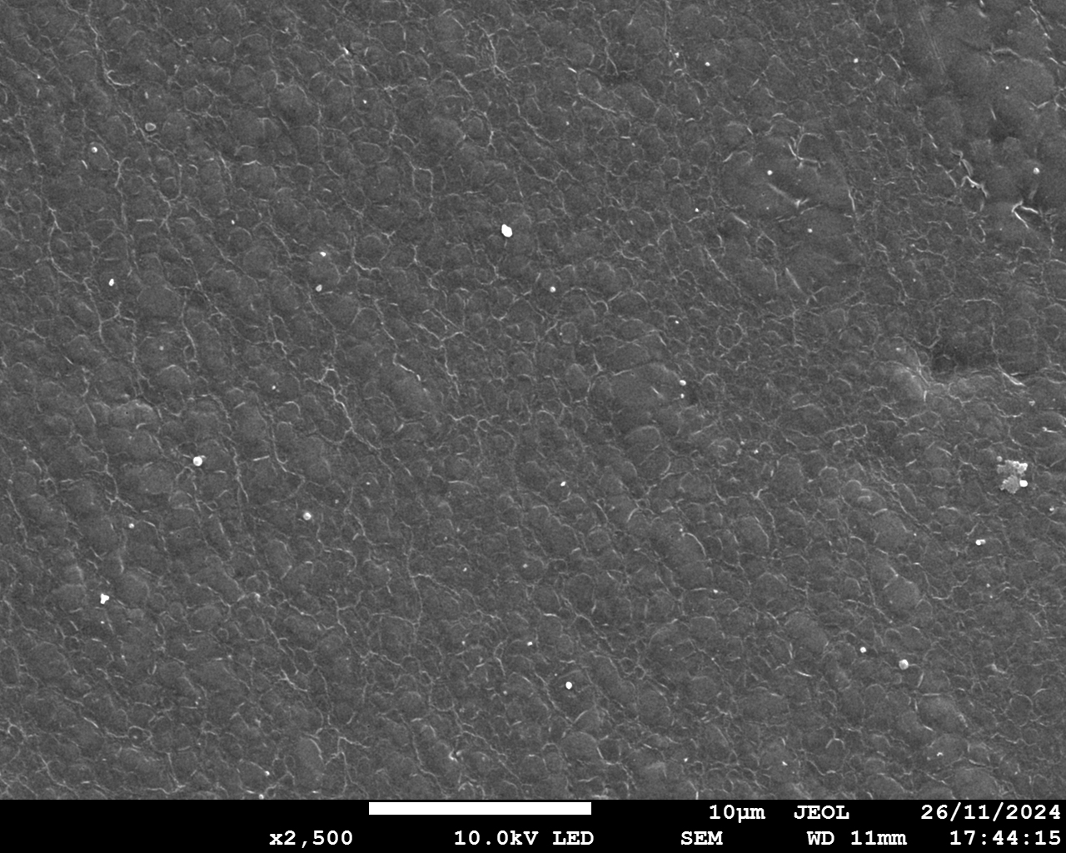
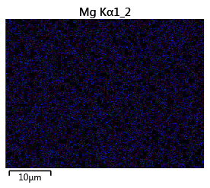
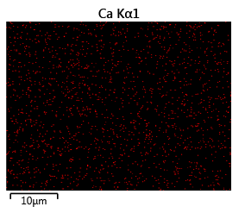
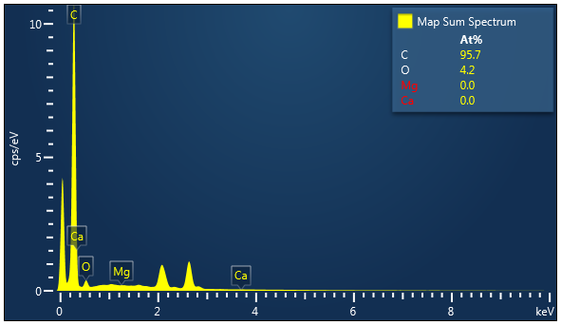
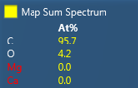
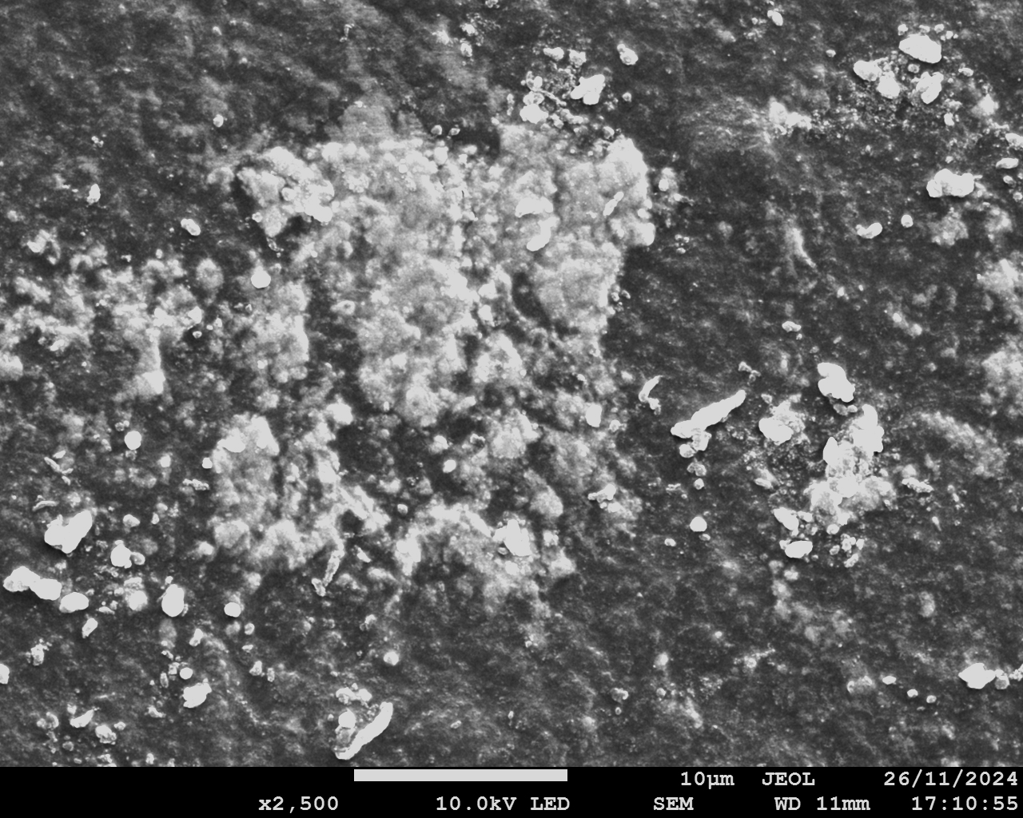
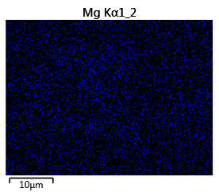
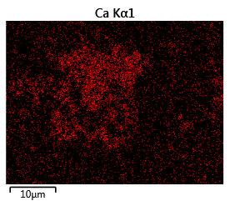
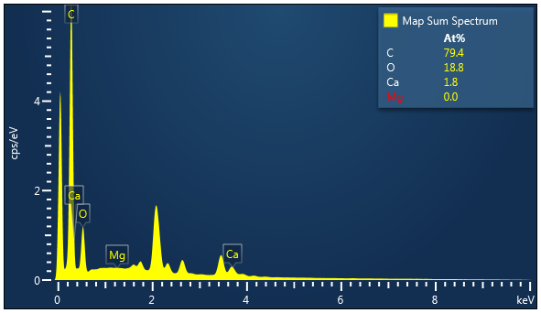
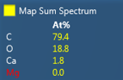
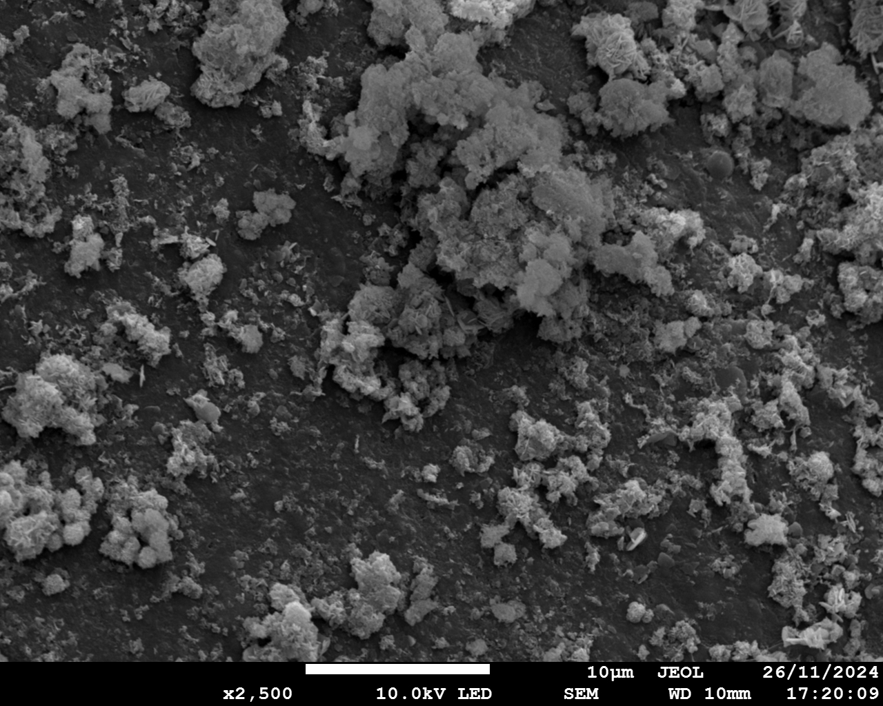
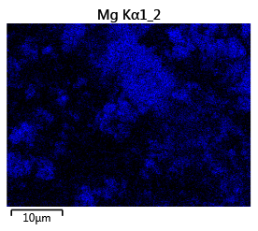
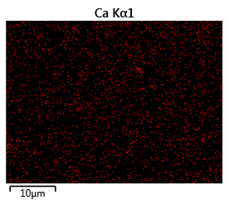
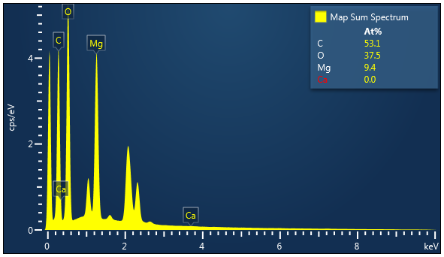
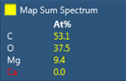
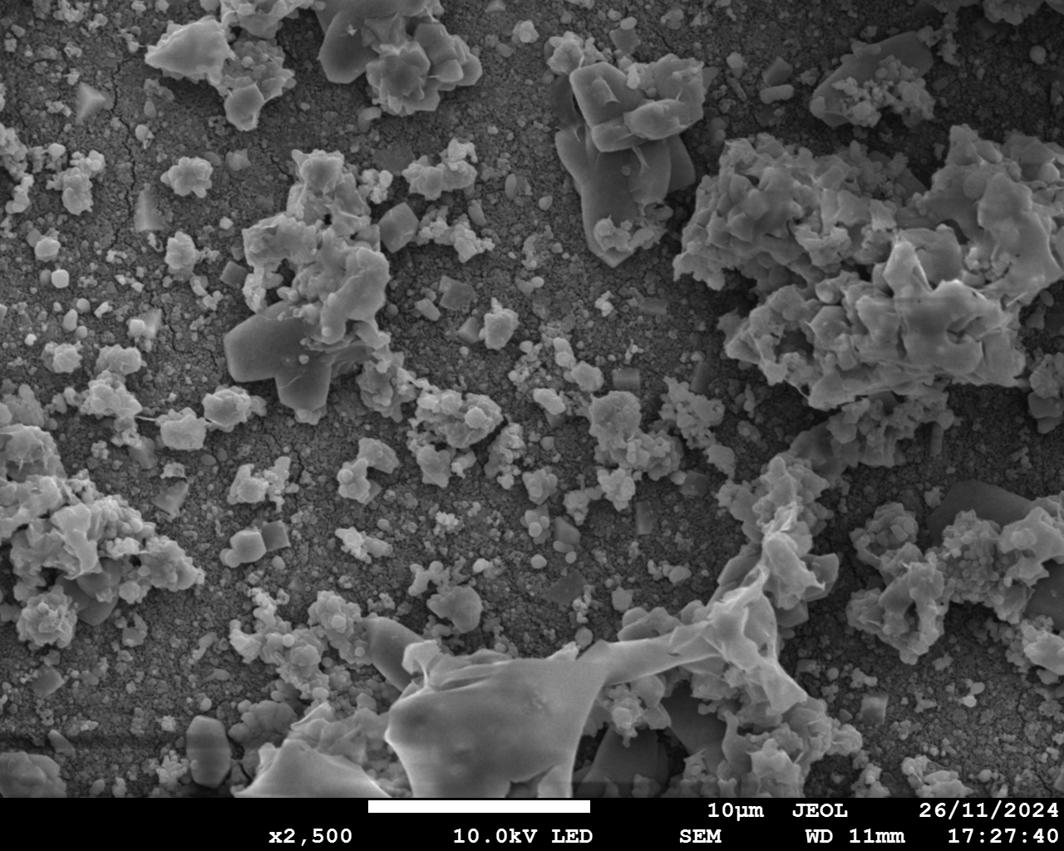
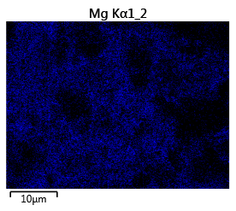
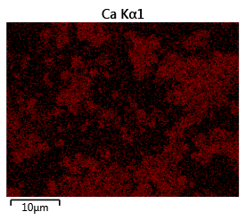
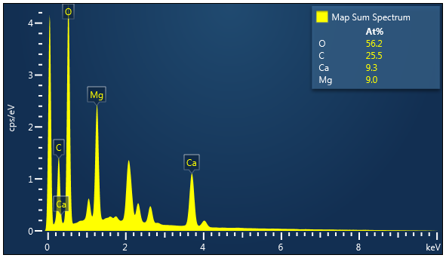
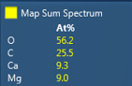
a1
a2
Mg
a3
Ca
a4
在图片前面加上膜的名字
按照后面图片的顺序放AEM，CEM/SCEM， BPM
10 μm
10 μm
10 μm
b1
b2
Mg
b3
Ca
b4
10 μm
10 μm
10 μm
c1
c2
Mg
c3
Ca
c4
10 μm
10 μm
10 μm
d1
d2
d3
d4
Mg
Ca
10 μm
10 μm
10 μm
Fig. 2 SEM and EDS elemental analysis of scaling…
Notes:
Fig. 2 Characterization of scaling on membranes (Conditions: Feed solution = seawater brine, current density = 15 mA/cm², cell pairs = 3, membrane = CEM. AC: acid chamber; SWBC: seawater brine chamber; BC: base chamber). AEM facing SWBC: (a1) SEM diagram; (a2) EDS elemental mapping image of Mg; (a3) EDS elemental mapping image of Ca; (a4) EDS map spectrum. BPM facing BC: (b1) SEM diagram; (b2) EDS elemental mapping image of Mg; (b3) EDS elemental mapping image of Ca; (b4) EDS map spectrum. CEM facing SWBC: (c1) SEM diagram; (c2) EDS elemental mapping image of Mg; (c3) EDS elemental mapping image of Ca; (c4) EDS map spectrum. CEM facing BC: (d1) SEM diagram; (d2) EDS elemental mapping image of Mg; (d3) EDS elemental mapping image of Ca; (d4) EDS map spectrum.

Slide 3
BPM
AEM
CEM/SCEM
BPM
BPM
Solution里的scaling 滤纸过滤分析
XRD。看下是否能在实验过程中测试turbidity。
左边重复单元表示，每一块的东西对应到相对应地chamber/箭头标一下 错位排列
每部分的XRD做一下 → 重新做一组BMED，有充足的scaling。1. 收集membrane 表面的scaling干燥后去做XRD；2. solution里的悬浮液过滤后取出scaling再做分析
-
EC
AC
+
SWBC
BC
EC
-
3
+
OH⁻
Cl⁻
Ca²⁺
+
-
…
+
1
2
-
OH⁻
H⁺
OH⁻
-
OH⁻
H⁺
+
Mg²⁺
Ca²⁺
Na⁺
-
Ca²⁺
Mg²⁺
Na⁺
+
+
-
1
2
3
Scaling on CEM/SCEM
facing SWBC
Scaling on CEM/SCEM
facing BC
Scaling on BPM
facing BC
Scaling: Mg(OH)₂
The leakage of OH⁻
Scaling: Mg(OH)₂, Ca(OH)₂, CaCO₃
The transport of Mg²⁺/Ca²⁺
Scaling: Ca(OH)₂
The transport of Mg²⁺/Ca²⁺
Notes:
Fig. 3 Schematic illustration of mechanisms of scaling generation in BMED system (EC: electrode chamber; AC: acid chamber; SWBC: seawater brine chamber; BC: base chamber).

Slide 4
a
b
Membrane 和solution的scaling能否分开算
Normalize（mg/L… 或者根据stack）
c
d
e
Notes:
Figure 4 Quantification of scaling in BMED system. (a) Reduction ratio of Mg²⁺ and Ca²⁺ with time; (b) The amount of scaling in BMED. The concentration change of Mg²⁺ and Ca²⁺ with time in (c) AC, (d) BC and (e) SWBC. (Conditions: Feed solution = seawater brine, current density = 15 mA/cm², cell pairs = 3, membrane = CEM. AC: acid chamber; BC: base chamber; SWBC: seawater brine chamber).

Slide 5
a
b
c
除了scaling还有什么因素会影响voltage
Acid base的concentration降低会不会导致solution的resistance变高
测试Acid和base chamber conductivity的变化
d
e
Notes:
Figure 5 (a) Conductivity changes in salt chamber and (b) Voltage changes in BMED system treating NaCl and seawater brine (SWB). (c) Concentration of generated acid and base with time. The current efficiency and energy consumption of the entire process to produce (d) acid and (e) base. (Conditions: Feed solution = SWB or NaCl, current density = 15 mA/cm², cell pairs = 3, membrane = CEM)

Slide 6
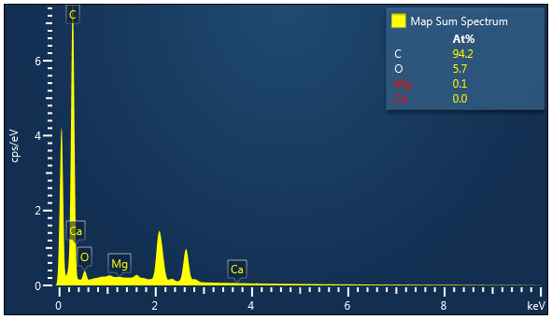
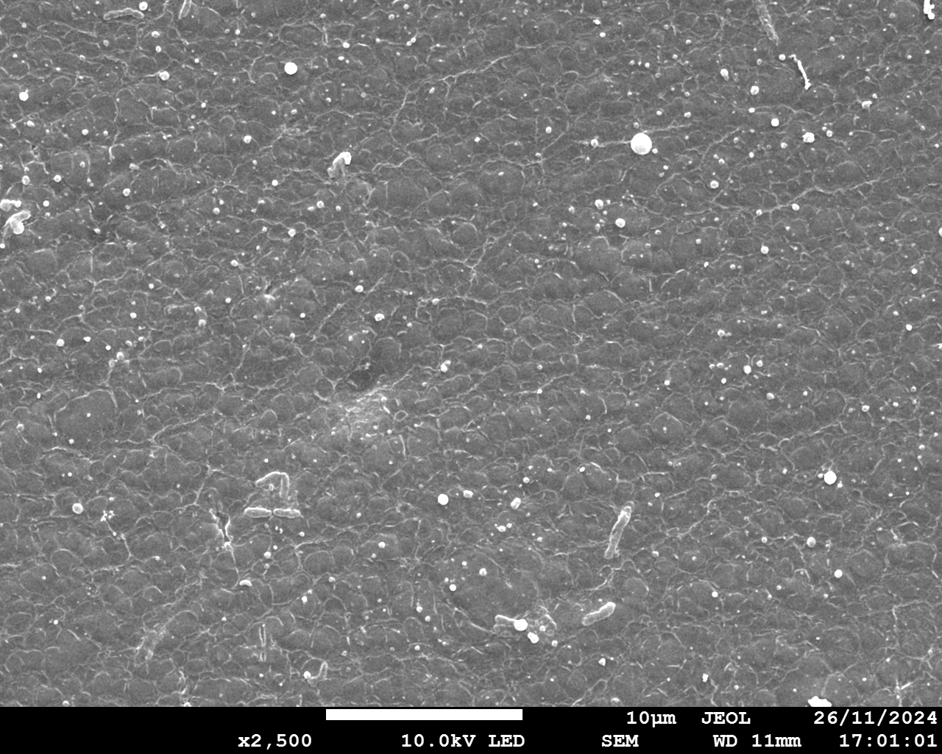
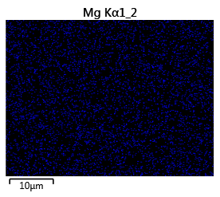
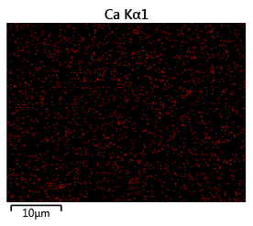
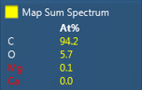
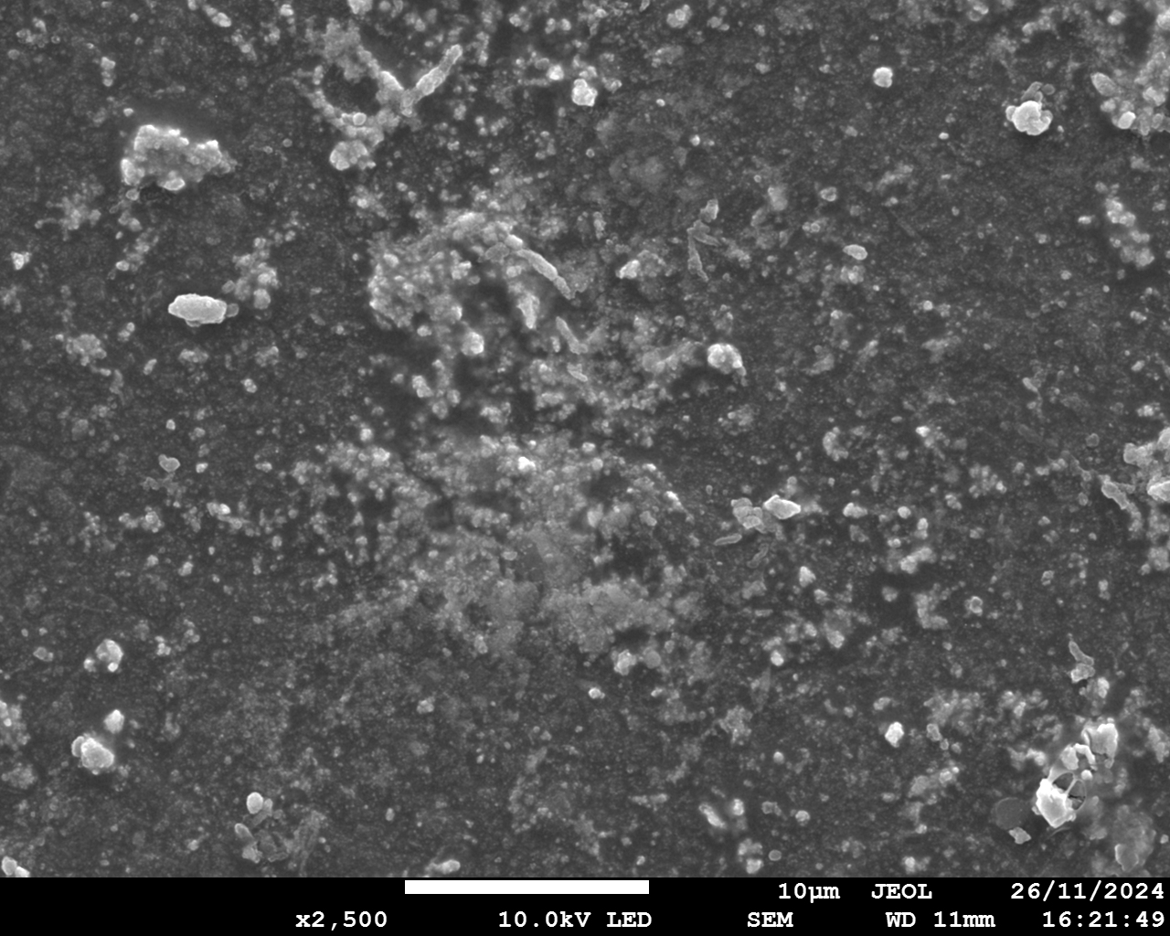
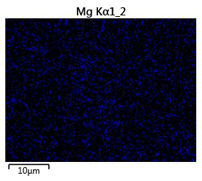
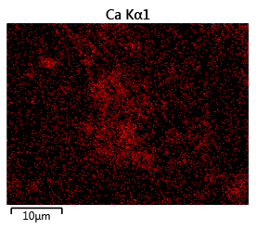
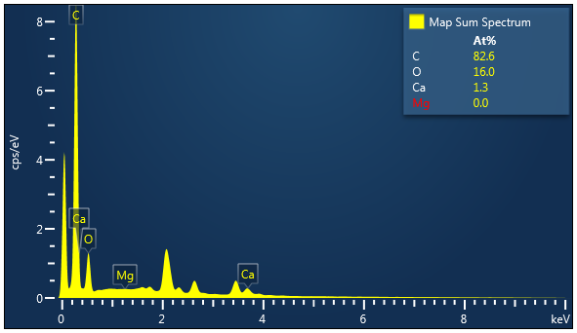
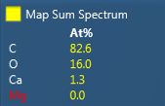
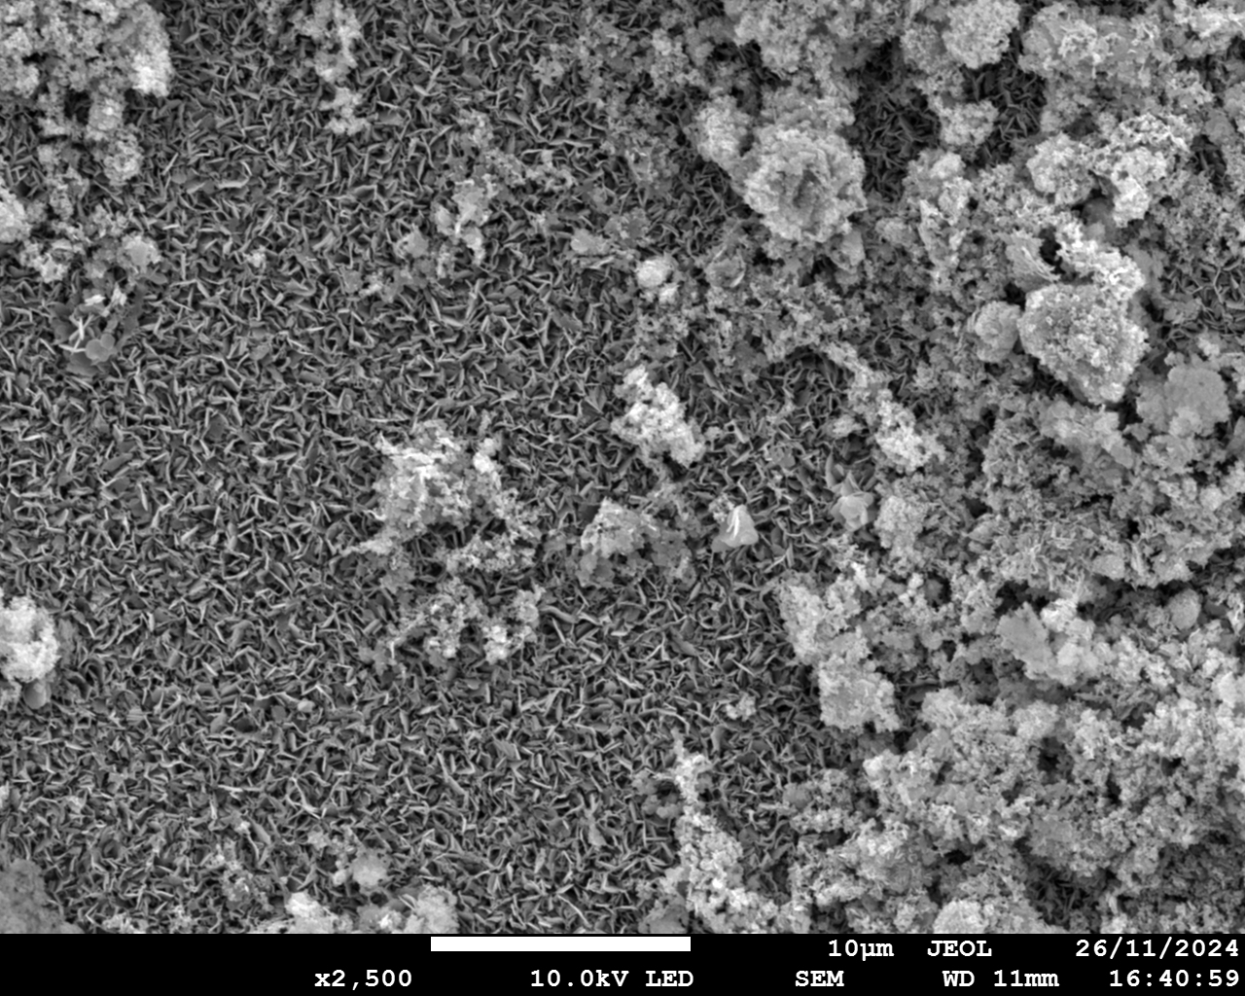
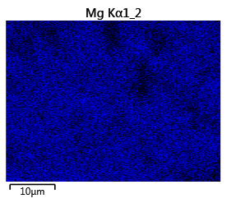
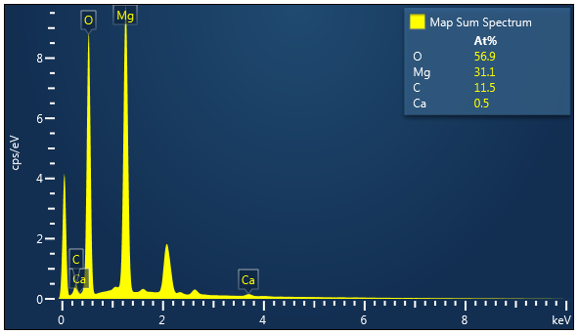
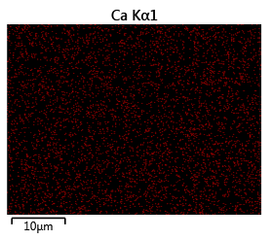
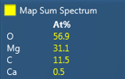
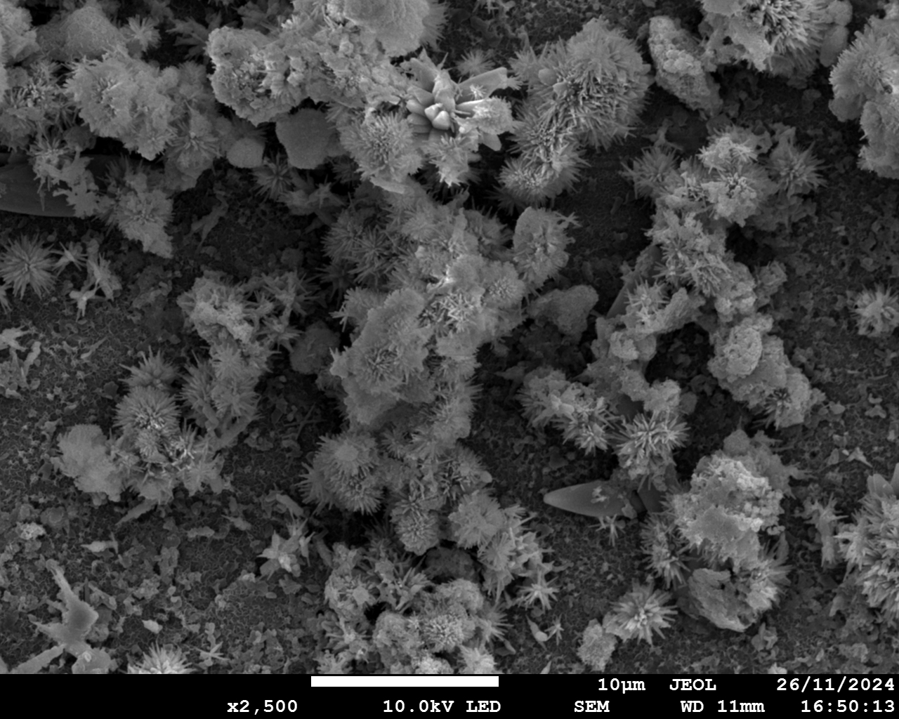
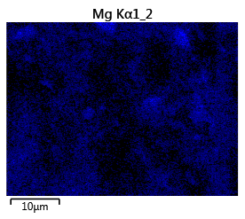
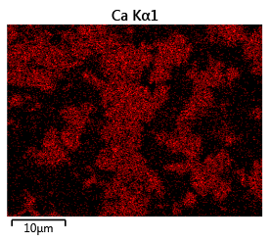
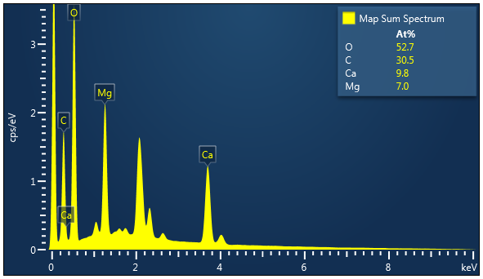
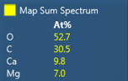
a1
a2
Mg
a3
Ca
a4
在图片前面加上膜的名字
按照后面图片的顺序放AEM，CEM/SCEM， BPM
10 μm
10 μm
10 μm
b1
b2
b3
b4
Mg
Ca
10 μm
10 μm
10 μm
c1
c2
Mg
c3
c4
Ca
10 μm
10 μm
10 μm
d1
d2
d3
d4
Mg
Ca
10 μm
10 μm
10 μm
Notes:
Figure 6 Characterization of scaling on membranes (Conditions: Feed solution = seawater brine, current density = 15 mA/cm², cell pairs = 3, membrane = SCEM). AEM facing SWBC: (a1) SEM diagram; (a2) EDS elemental mapping image of Mg; (a3) EDS elemental mapping image of Ca; (a4) EDS map spectrum. BPM facing BC: (b1) SEM diagram; (b2) EDS elemental mapping image of Mg; (b3) EDS elemental mapping image of Ca; (b4) EDS map spectrum. SCEM facing SWBC: (c1) SEM diagram; (c2) EDS elemental mapping image of Mg; (c3) EDS elemental mapping image of Ca; (c4) EDS map spectrum. SCEM facing BC: (d1) SEM diagram; (d2) EDS elemental mapping image of Mg; (d3) EDS elemental mapping image of Ca; (d4) EDS map spectrum.

Slide 7
a
b
label颜色的问题
柱状图无填充，斜线表示
同一种membrane用同一种颜色，label不一样
c
d
e
Notes:
Figure 7 Quantification of scaling in BMED system (Conditions: Feed solution = seawater brine, current density = 15 mA/cm², cell pairs = 3, membrane = CEM (baseline, BL) and SCEM. AC: acid chamber; SWBC: seawater brine chamber; BC: base chamber). (a) Reduction ratio of Mg²⁺ and Ca²⁺ in BMED system treating SWB with different membrane stack; (b) The amount of scaling in BMED system with different membrane stack. The concentration change of Mg²⁺ and Ca²⁺ with time in (c) AC, (d) BC and (e) SWBC.

Slide 8
a
b
c
d
e
Notes:
Figure 8 (a) Conductivity change in salt chamber and (b) Voltage change with different membrane stack. (c) Concentration of generated acid and base with different membrane stack. The current efficiency and energy consumption of the entire process to produce (d) acid and (e) base with different membrane stack. (Conditions: Feed solution = seawater brine, current density = 15 mA/cm², cell pairs = 3, membrane = CEM (BL) and SCEM).

Slide 9
a
b
a
b
Salt solution 的 pH…
c
d
e
Notes:
Figure 9 Quantification of scaling under different current density (Conditions: Feed solution = seawater brine, cell pairs = 3, membrane = SCEM, current density = 15 (BL), 12 and 9 mA/cm². AC: acid chamber; SWBC: seawater brine chamber; BC: base chamber). (a) Reduction ratio of Mg²⁺ and Ca²⁺ in BMED system treating SWB under different current density; (b) The amount of scaling in BMED system under different current density. The concentration change of Mg²⁺ and Ca²⁺ with time in (c) AC, (d) BC and (e) SWBC.

Slide 10
a
b
c
d
e
CD的顺序从低往高
Notes:
Figure 10 (a) Conductivity change in salt chamber and (b) Voltage change with time under different current density. (c) Concentration of generated acid and base under different current density. The current efficiency and energy consumption of the entire process to produce (d) acid and (e) base under different current density. (Conditions: Feed solution = seawater brine, cell pairs = 3, membrane = SCEM, current density = 15 (BL), 12 and 9 mA/cm²).

Slide 11
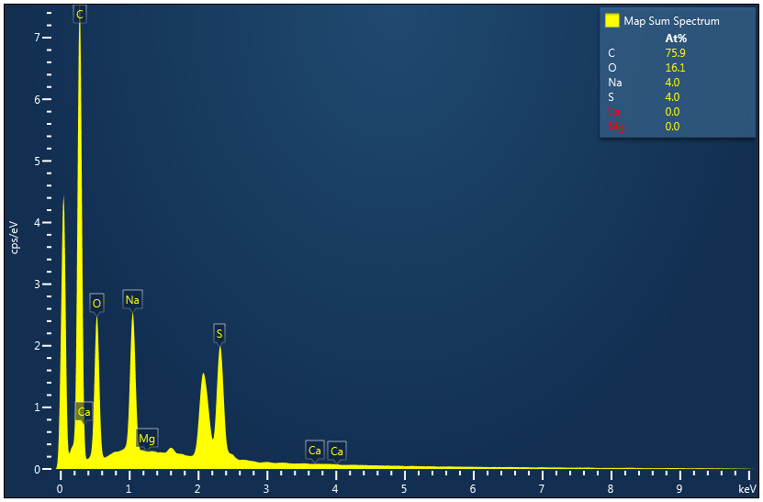
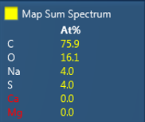
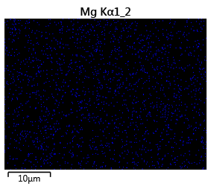
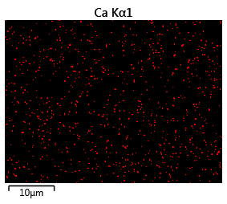
a
b
10 μm
c
Mg
d
Ca
10 μm
10 μm
Notes:
Figure S 1 Characterization of CEM (Conditions: feed solution = NaCl, current density = 15 mA/cm², cell pairs = 3). (a) SEM graph; (b) EDS map spectrum; (c) EDS elemental mapping image of Mg; (d) EDS elemental mapping image of Ca.

Slide 12
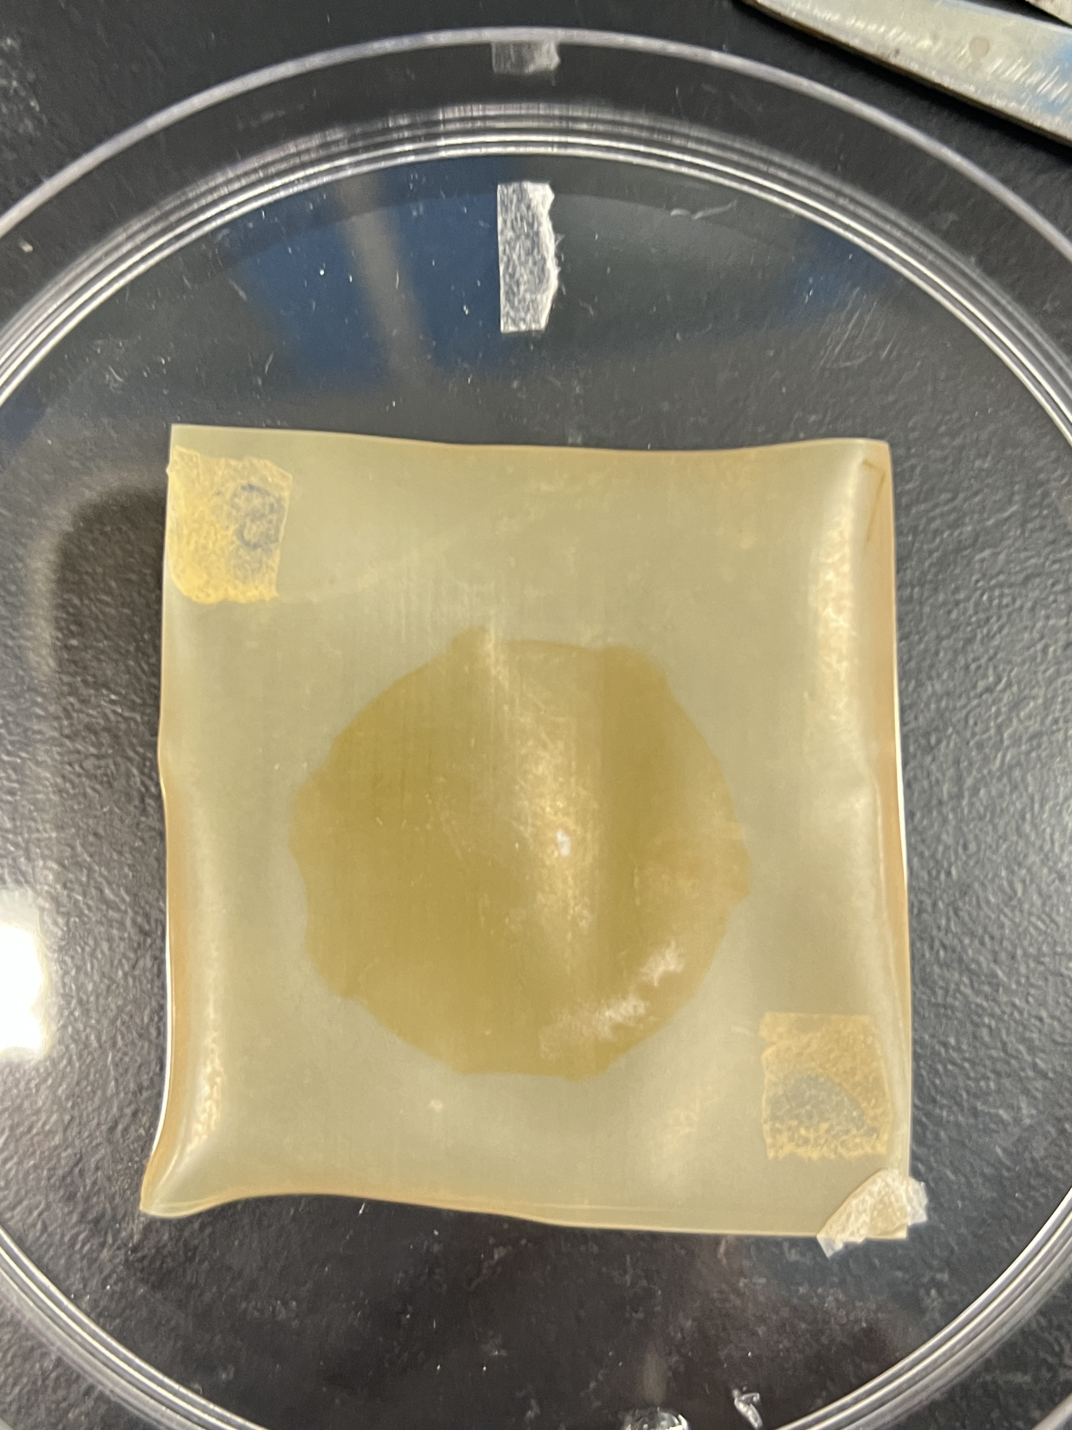
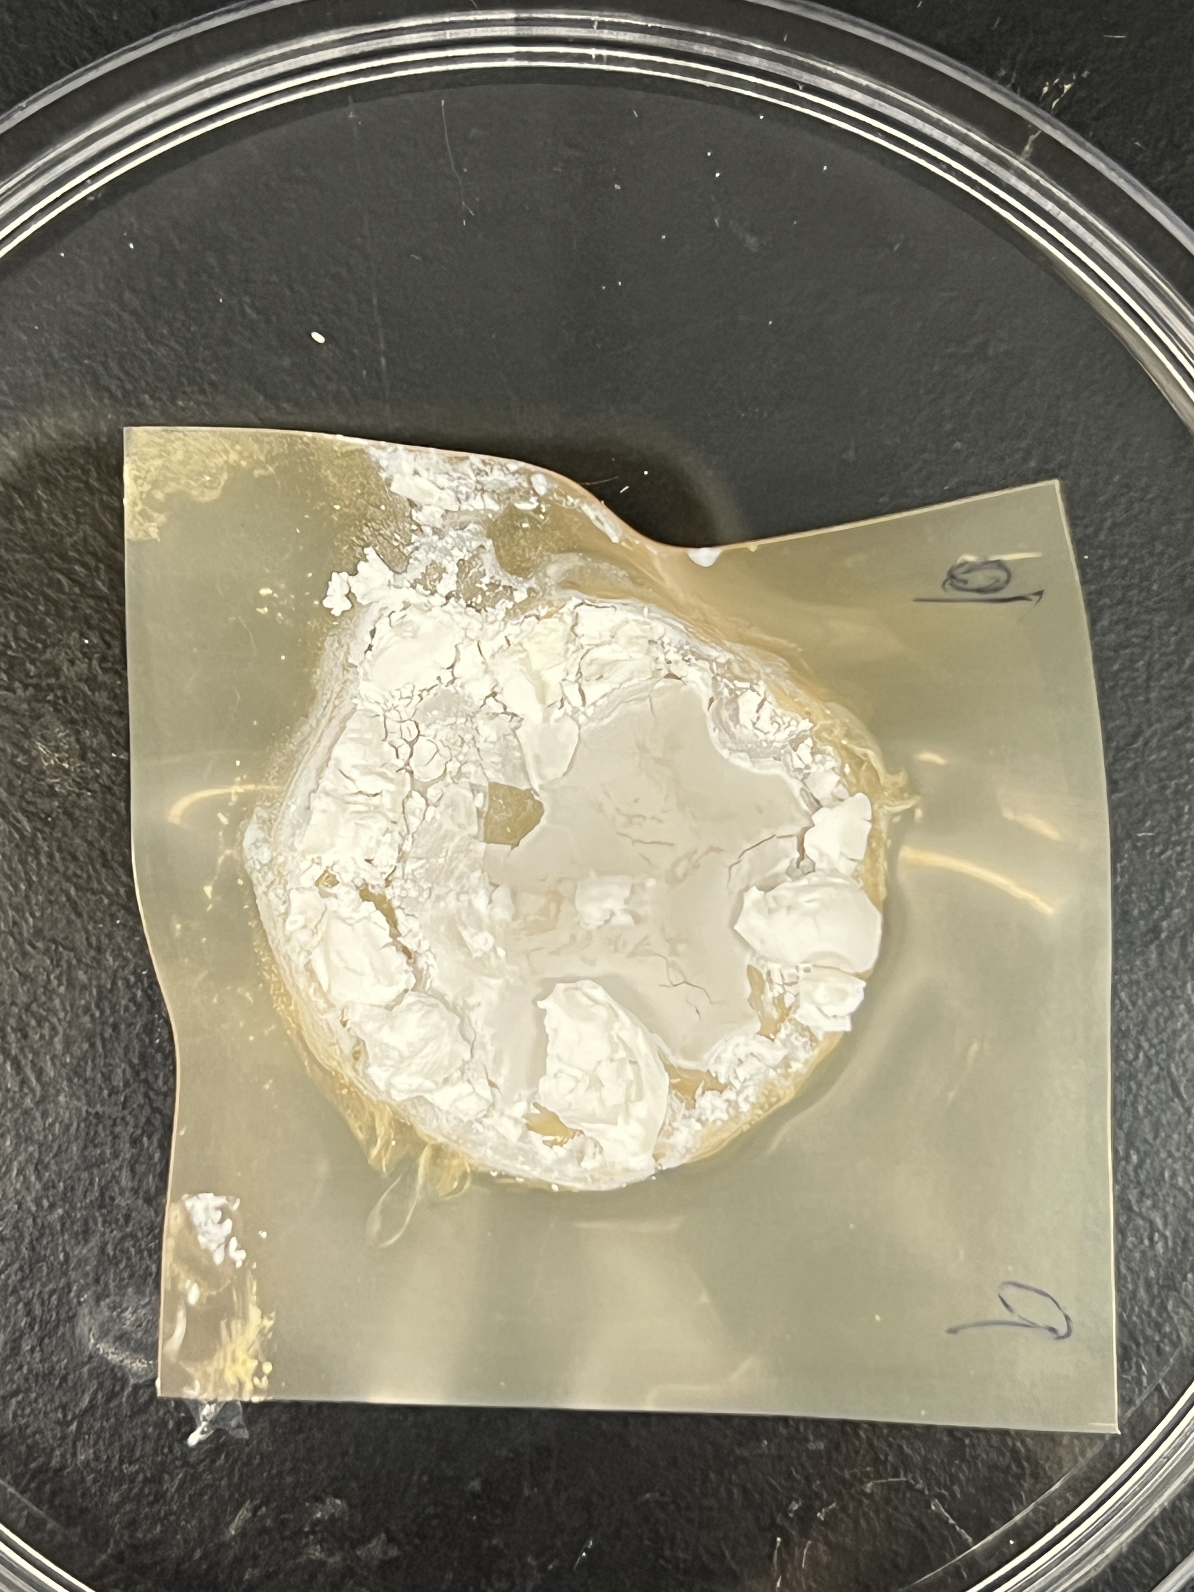
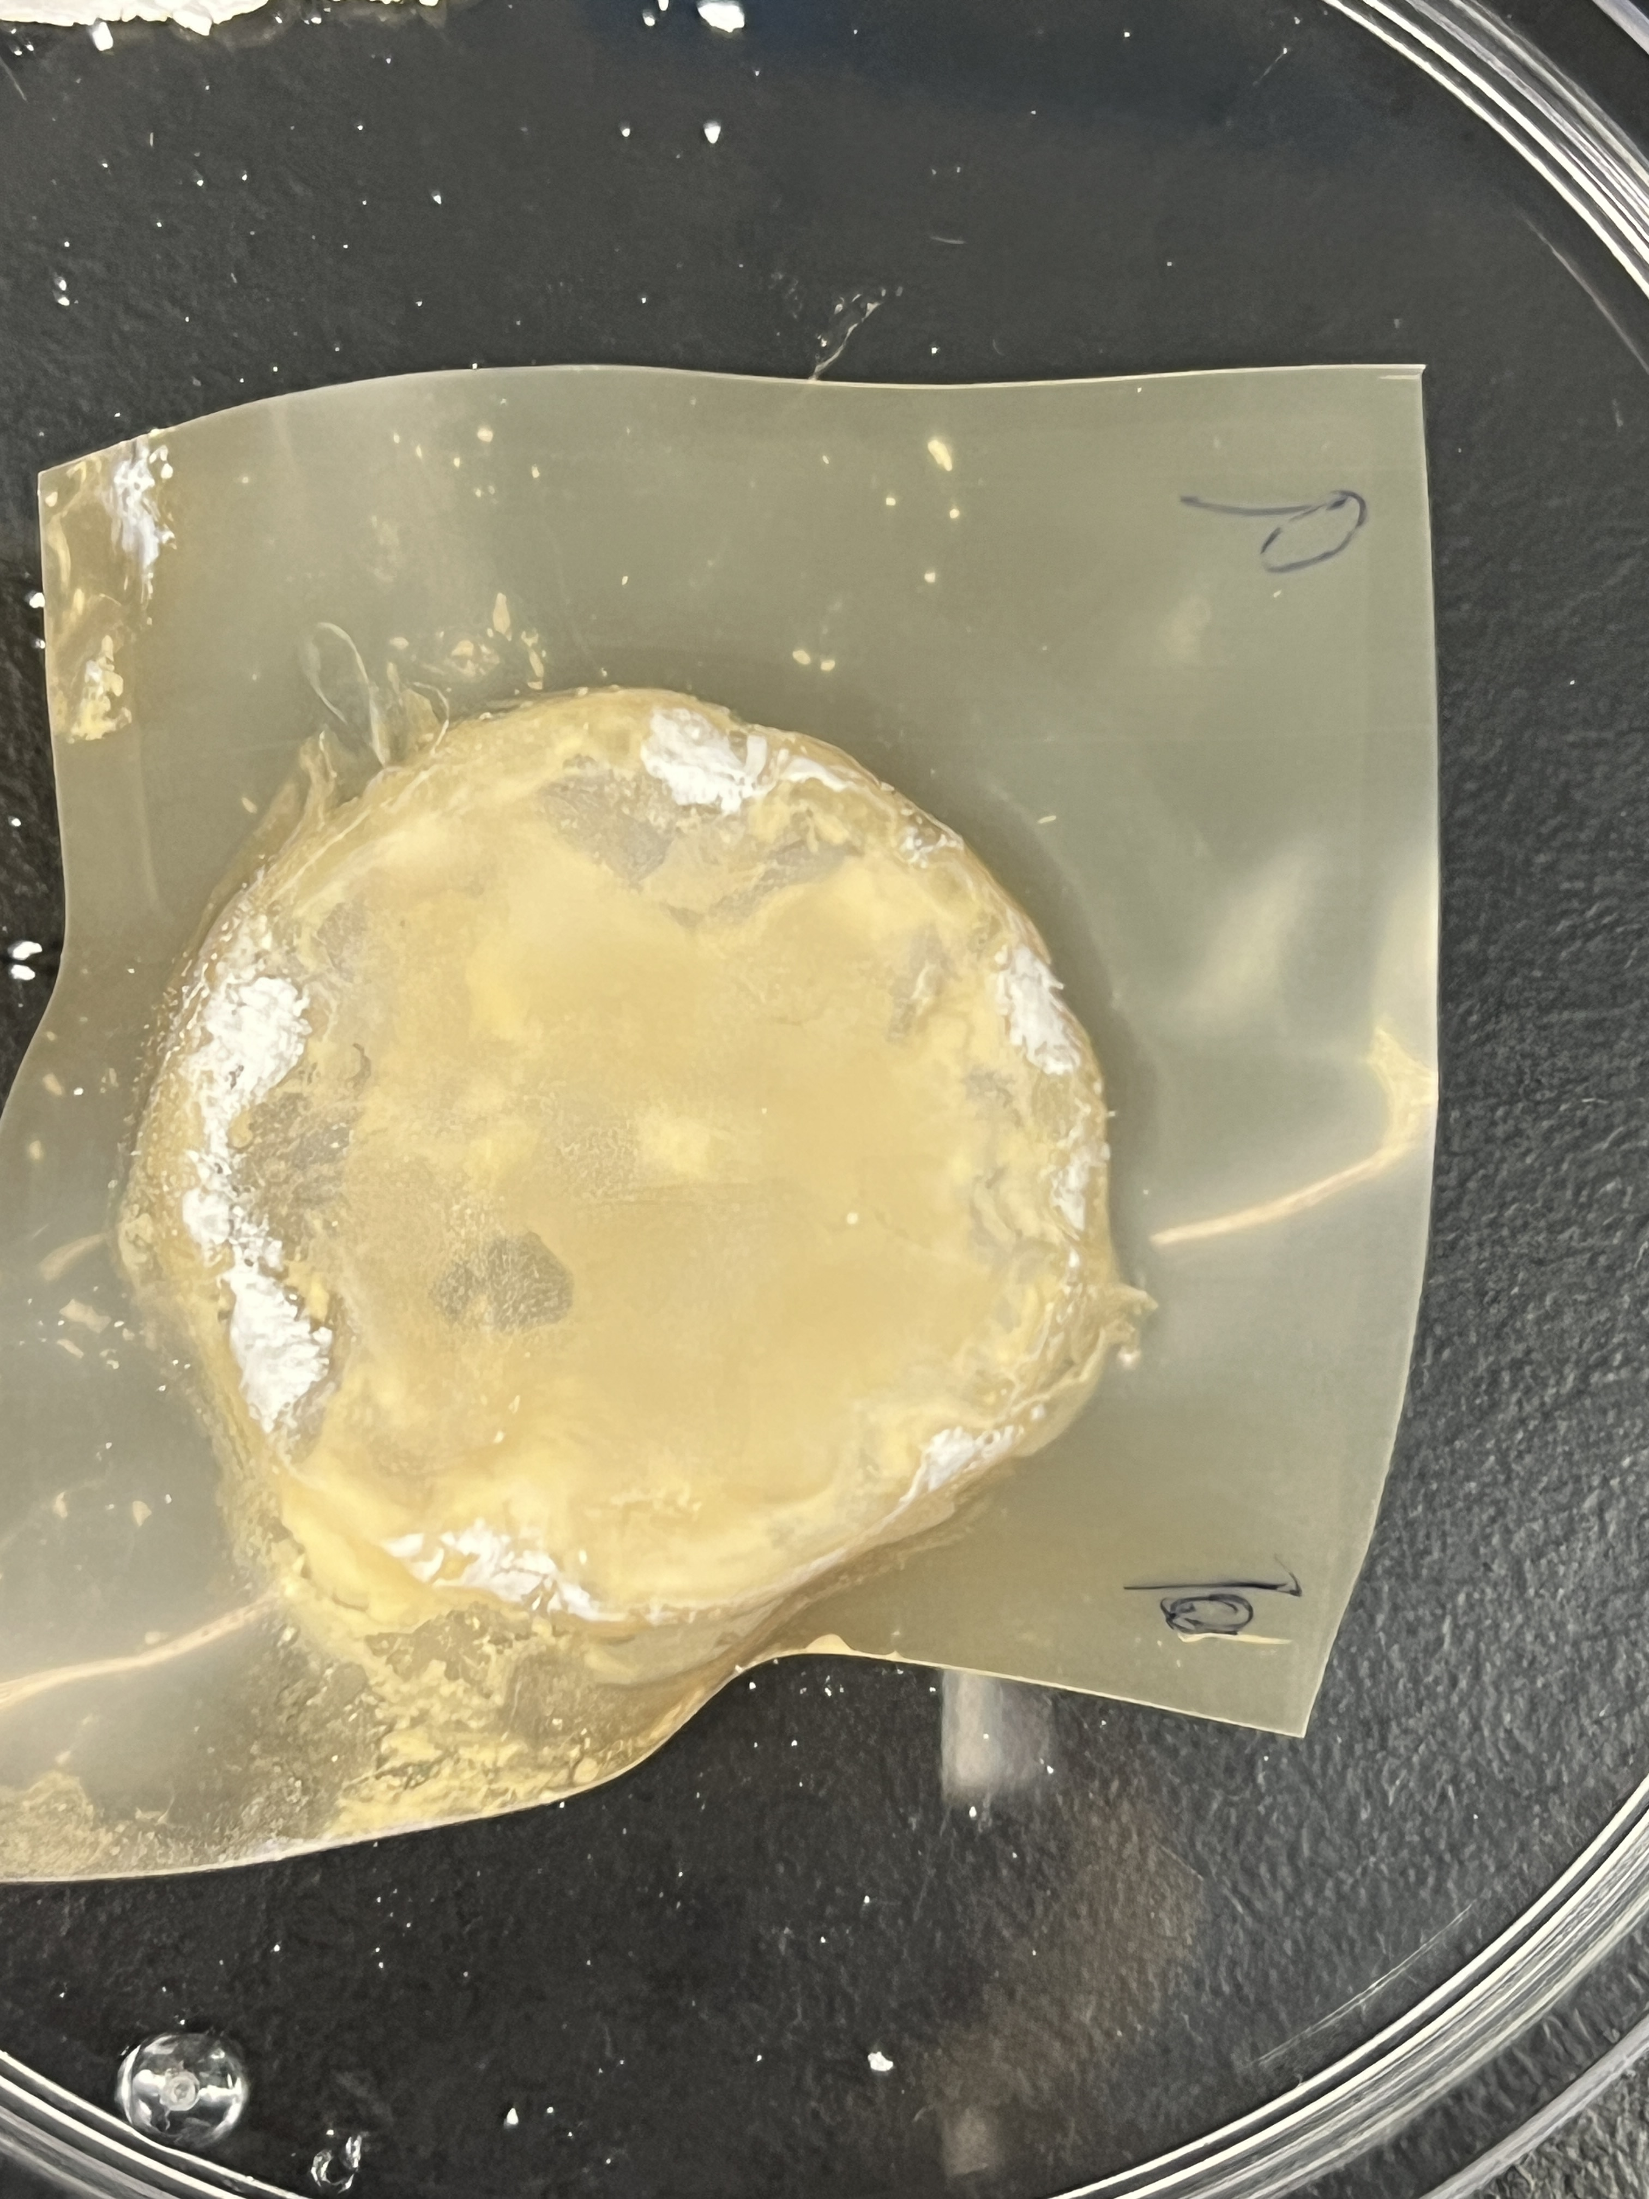
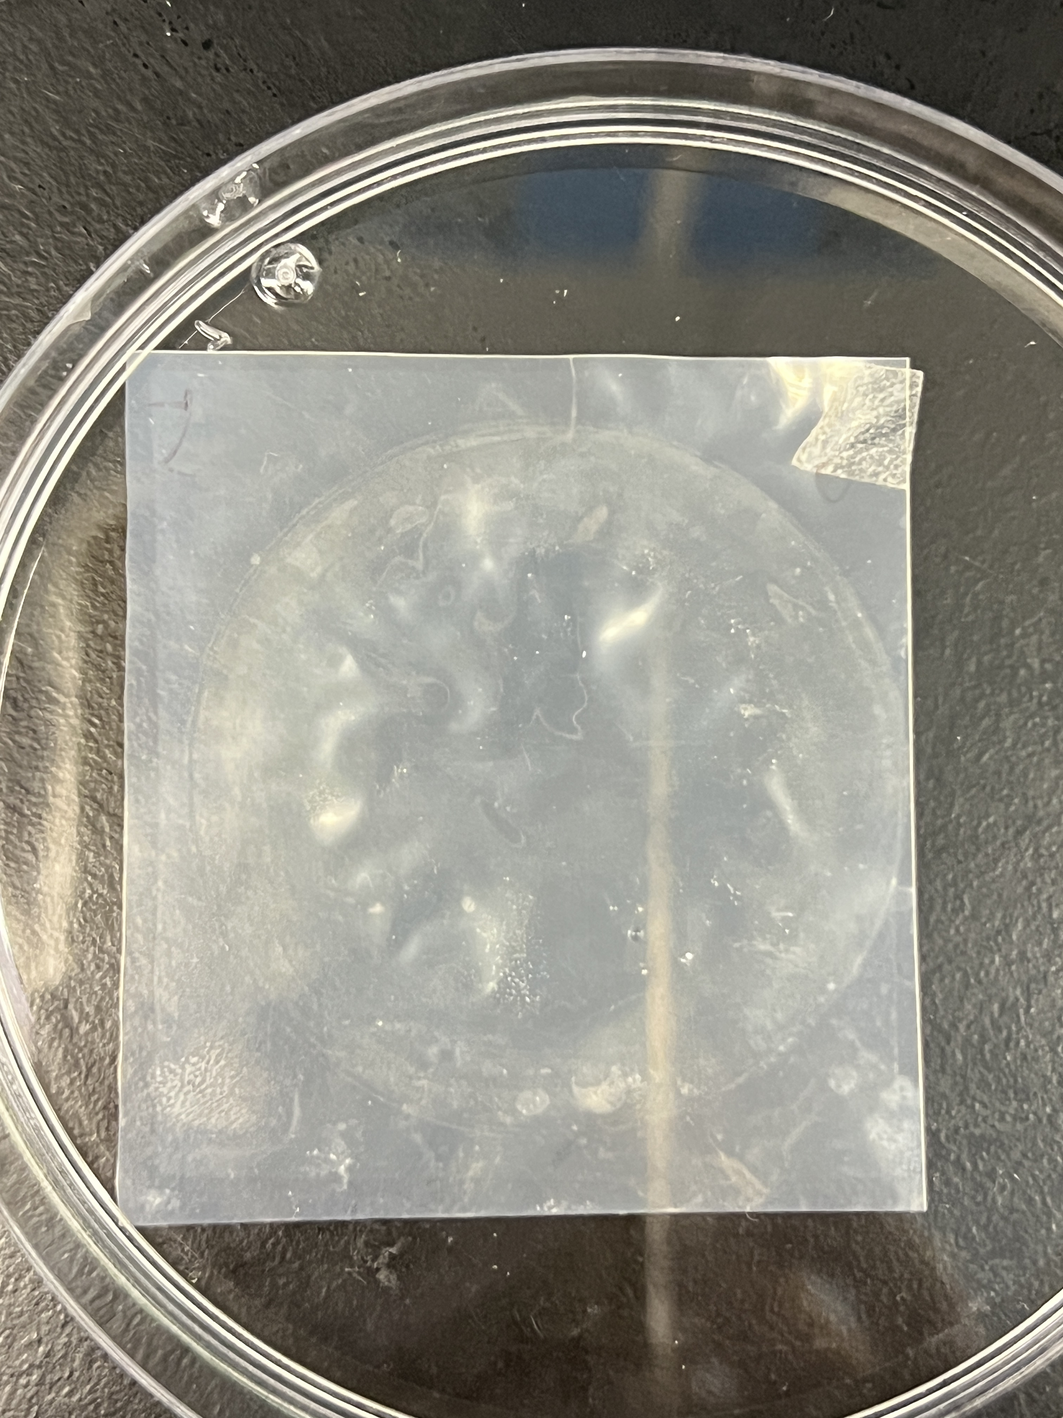
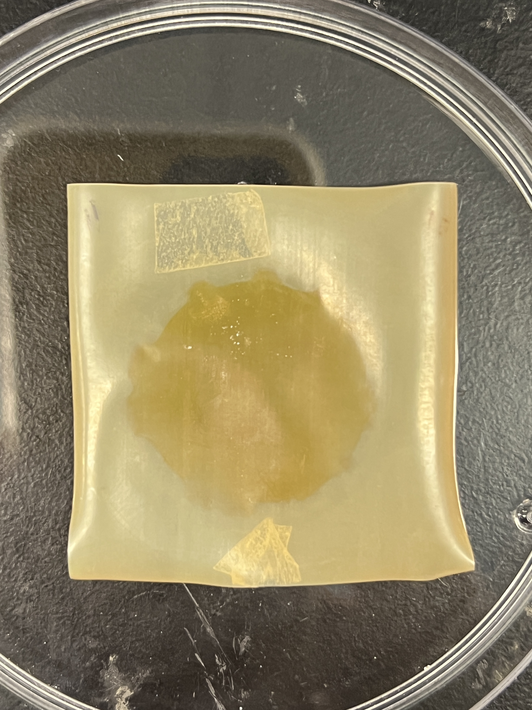
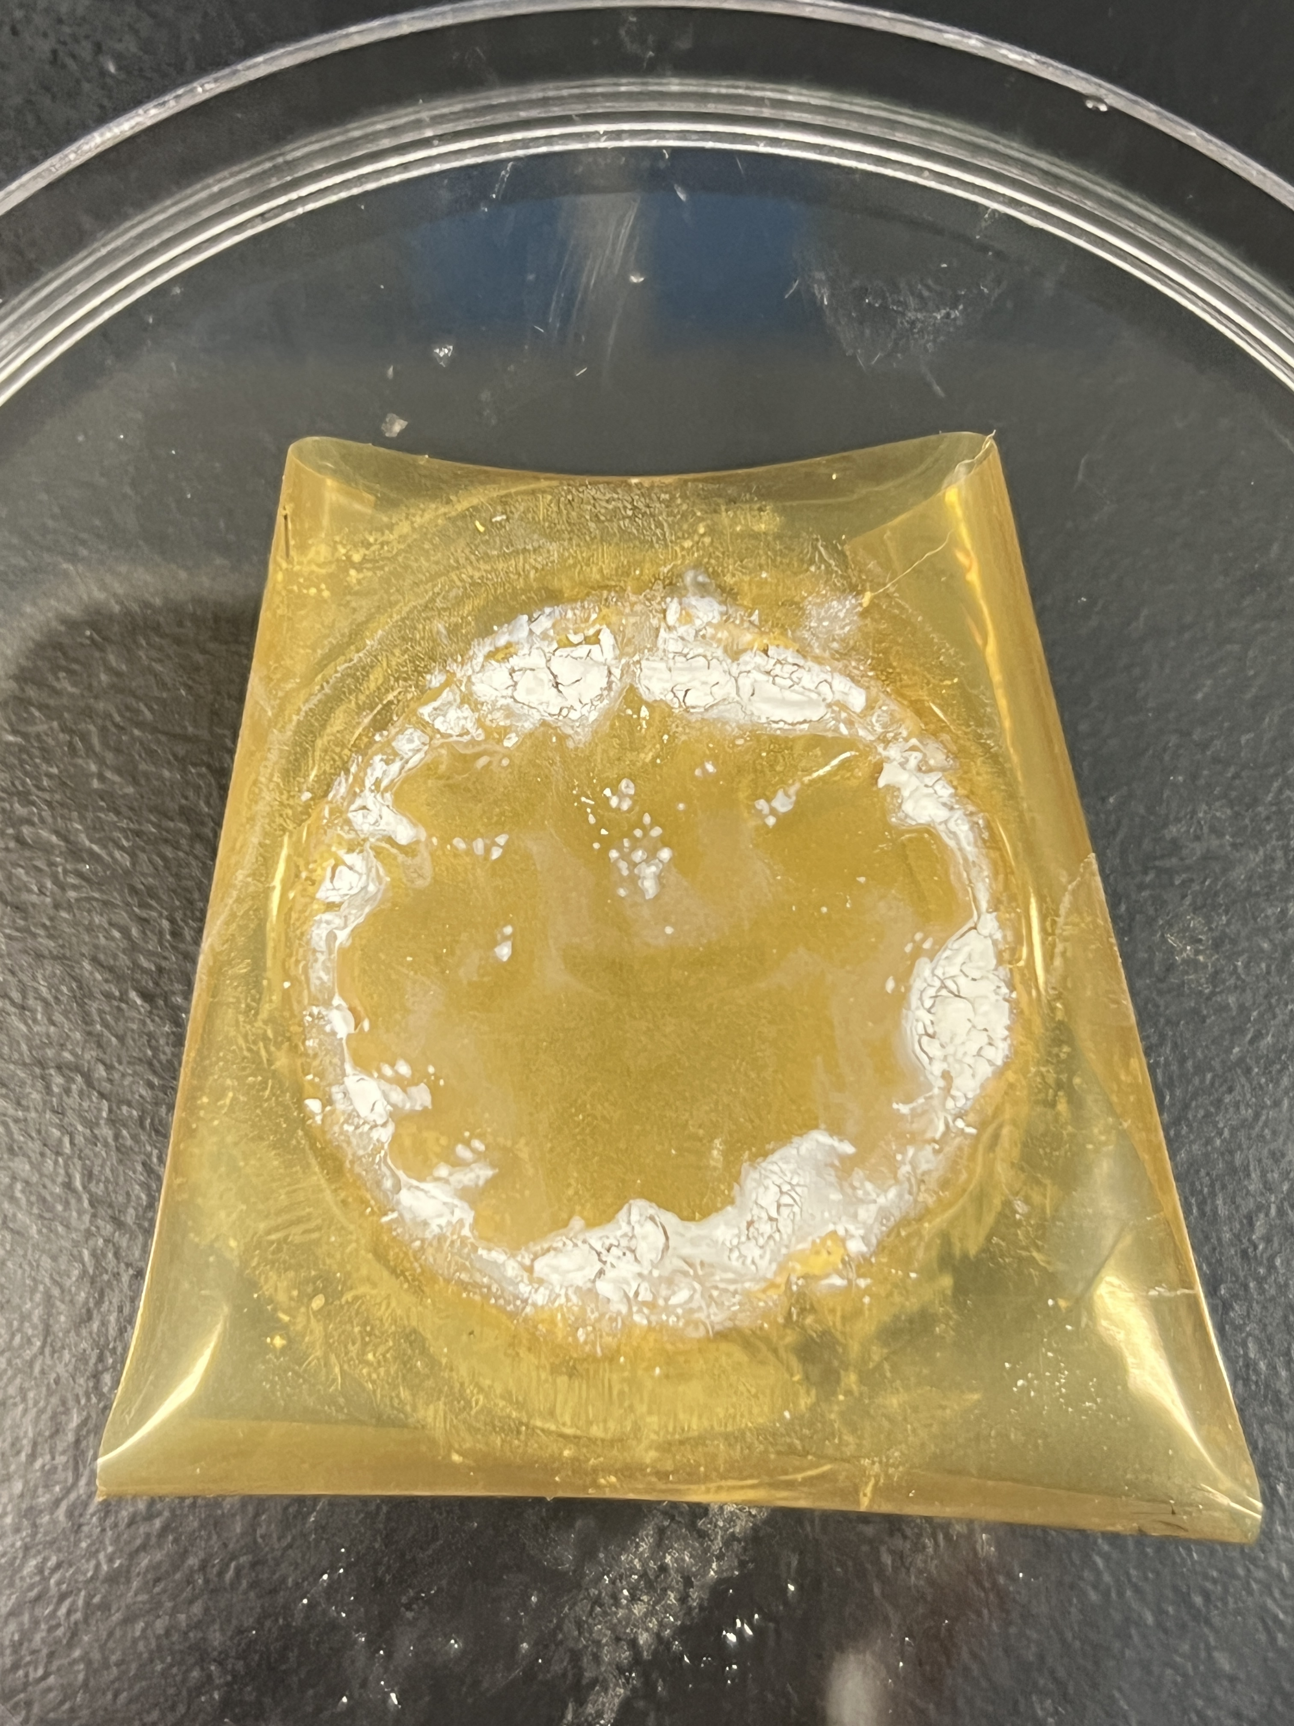


a1
a2
a3
a4
AEM facing SWBC
BPM facing BC
CEM facing SWBC
CEM facing BC
b1
b2
b3
b4
AEM facing SWBC
BPM facing BC
SCEM facing SWBC
SCEM facing BC
Notes:
Figure S2 The photo of membranes after test. BMED with CEM: (a1) AEM facing SWBC; (a2) BPM facing BC; (a3) CEM facing SWBC; (a4) CEM facing BC. BMED with SCEM: (b1) AEM facing SWBC; (b2) BPM facing BC; (b3) SCEM facing SWBC; (b4) SCEM facing BC.

Slide 13






a1
a2
AEL
BPM的cross section只放一个
做一下CEM的cross-section
CEL
10 μm
b1
b2
CEL
AEL
10 μm
Notes:
Fig. S3 The SEM graph and EDS map spectrum of cross-section of BPM

